Slide 1
End-to-End Big Data Workshop
Dave Wentzel
linkedin.com/in/dwentzel
git.davewentzel.com/demos/EndtoEndBigData
github.com/davew-msft/E2EBigData
Wifi:
Msftguest
Attendee code: msevent527cw

Slide 2
We had a successful workshop if…
…you understand the differences between Artificial Intelligence, Machine Learning and Deep Learning, and the problems Deep Learning addresses
…build a Deep Learning Solution on Azure Databricks
…understand some practical use cases for Big Data Pipelines

Slide 3
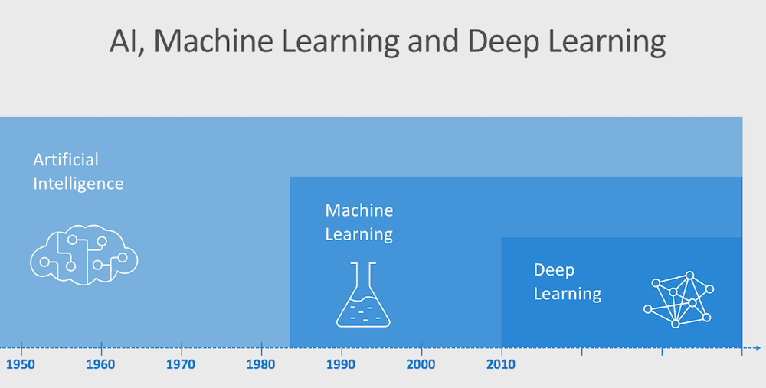
Notes:
Any system that mimics human behavior
Decision trees
Expert systems
Msft definition today
Ai winter due to hype, lack of data and compute
---
Data mining
And lots of data
Math to improve the data
Features and labels
---
Take a stack of algos and apply math
NNs
“layers”

Slide 4


Complex Predictions and Classifications
Notes:
ML can tell you that’s a dog or not
But likely can’t tell you it’s a Labrador retriever
Classic dl problem

Slide 5

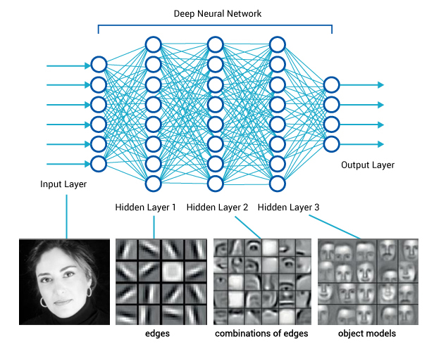

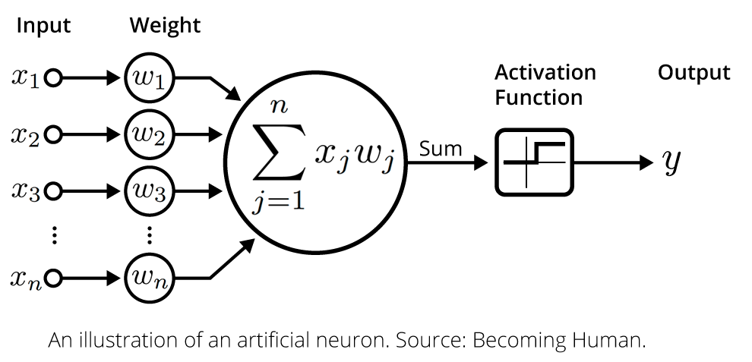
Understanding Deep Learning Learning through layers
Notes:
Axons, neurons, dendrites
Activation function: does the next neuron care?
Sigmoid
Backpropogation: the result is sent back through the system again.
DL: needs more and more data vs diminishing returns
It’s just math
Takes a lot of hardware and a lot of time

Slide 6
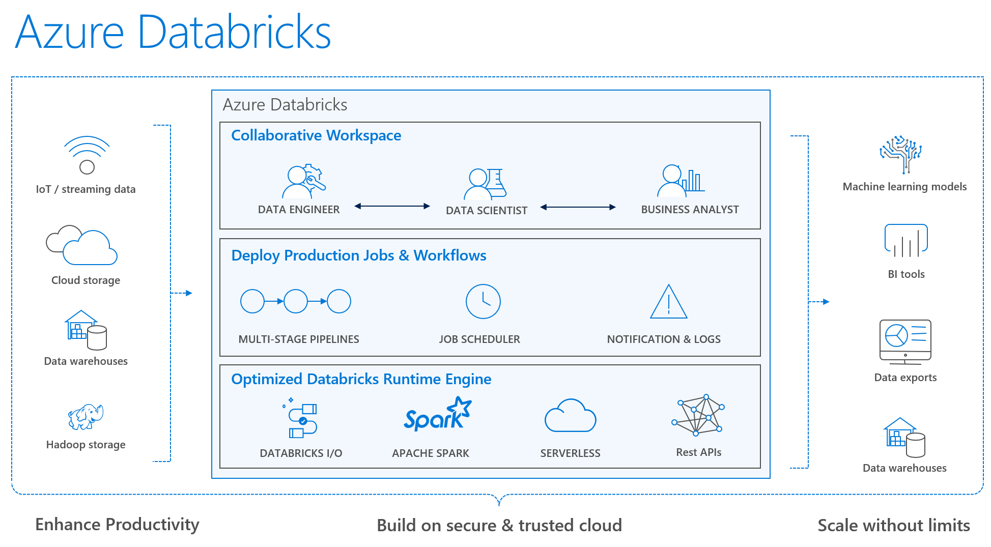
Notes:
Databricks history
Data engineers

Slide 7
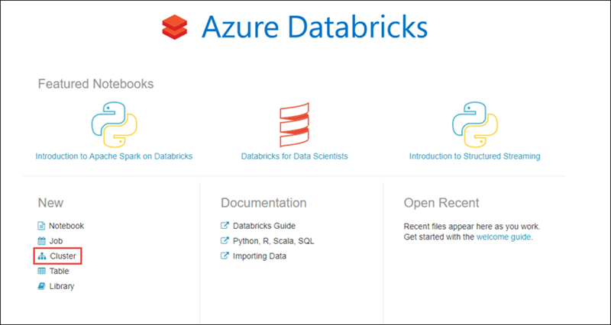
QuickStart 5-minute guide to Databricks
Notes:
20:00

Slide 8
Let’s spin one up!

Slide 9
Distributed Deep Learning with Azure Databricks

Slide 10
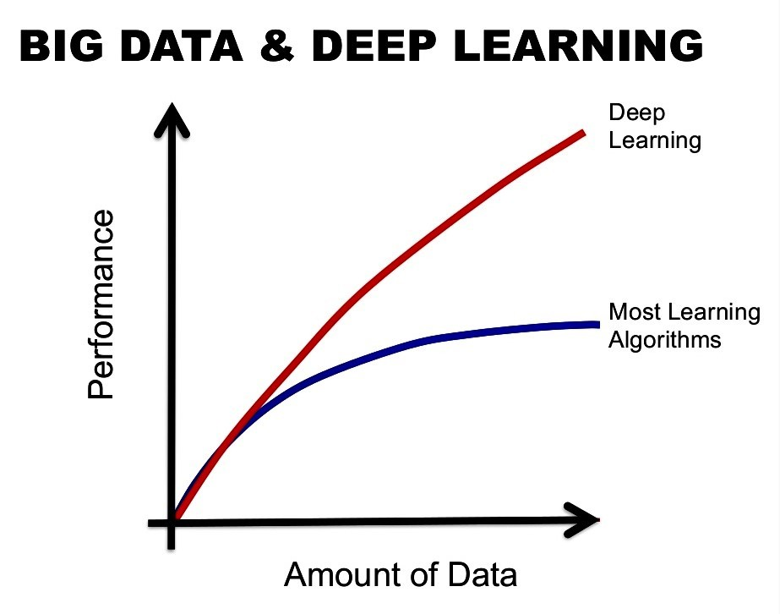
Why Distributed Deep Learning
Value to customers:
DL is known for improving with data
Scale DL training from single node
Improve training speed & reduce time-to-value
Notes:
From Andrew Ng/coursera
DL
train on single node
distributed

Slide 11



How Azure Databricks Helps Deep Learning
Highly performant and reliable data pipelines
Cutting-edge AI models at massive scale
Highly iterative and collaborative process
Pre-configured ML frameworks with simplified distributed training and GPU instances support
Optimized and managed Apache Spark runtime improves data reliability
Unified Workspaces for data engineers and data scientists to collaborate and iterate across the entire lifecycle
Notes:
Data prep is 80%
Dbricks is great just for ETL
Installing ML/DL frameworks
Work as a team

Slide 12
Accelerating DL on Azure Databricks
Data Preparation
Model Training
Model Production
Flexibility | Scalability | Usability
Notes:
3 things you need to do for data science
It’s a matrix with the ilities
The problem is the top
The bottom is the solution

Slide 13
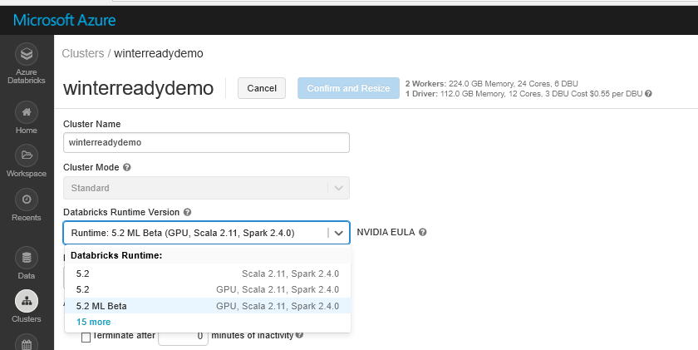



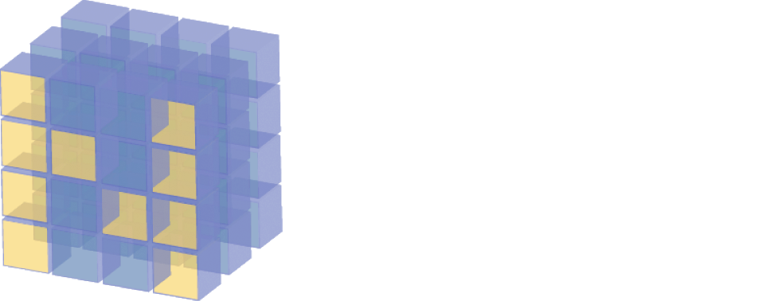



Getting Started
Easily set up ML environments on all cluster nodes with a single click
Leverage pre-configured ML/DL libraries
Notes:
It is not easy to deploy the frameworks
Horovod is not easy
Time to market
Now let’s spin up a cluster

Slide 14
DL Workflow: Data Preparation
Data Preparation
Model Training
Model Production
Workflow
Transformation
Training models
Inferencing
Loading
Tuning hyperparameters
Current Status
Optimized data I/O and model checkpointing for distributed training using Blob Fuse client Spark has more than 50+ connectors to diverse data sources
Notes:
Shuffles in spark
Checkpointing
Days for training

Slide 15
DL Workflow: Model Training
Data Preparation
Model Training
Model Production
Workflow
Transformation
Training models
Inferencing
Loading
Tuning hyperparameters
Current Status
Distributed Deep Learning Training: released HorovodRunner that enables migration from Single-Machine to distributed DL training with a few changes while achieving 70-80% scaling efficiency
Notes:
pickle files (python)
Formulas
Export to something else (not spark)

Slide 16

HorovodRunner
HorovodRunner provides a simple way to scale up your deep learning training workloads from a single machine to large clusters
Leverages Project Hydrogen and new Spark 2.4 barrier execution mode
Built on top of Horovod
70-80% scaling efficiency
Supports TensorFlow, Keras and PyTorch
Notes:
Impedence mismatch: Spark doesn’t understand DL, it understands distributed python
Can’t do scaling and optimization
Dbricks makes this more spark aware

Slide 17
DL Workflow: Model Production
Data Preparation
Model Training
Model Production
Workflow
Transformation
Training models
Inferencing
Loading
Tuning hyperparameters
Notes:
Cloud or edge
Containerization
MLFlow
AMLS

Slide 18
The Basics Workshop
Notes:
Load admin.dbc
We start you off executing cells, then you do it yourself
Go through each notebook
02: we mount vs local storage
03: parquet, infer schema issues
Transforms vs actions
the sql mindset
04: stream from blob
041:
Basic EH overview, and on portal
at-least-once
06: this is exploratory data science from scratch

Slide 19
Lab 01 Data Exploration
Notes:
This is basic data profiling lab
Go over uploading the data

Slide 20
Lab 02 Supervised Learning Lab 03 Advanced Supervised Learning and Tuning
Notes:
What is it?
Classification
Regression
Pipeline model:
inferencing
feature preparation
Text:
hashing to create numeric vectors
Advanced:
evaluate your models
confusion matrix
ROC/AUC
RMSE
tune parameters
use cross validation

Slide 21
Using Azure Databricks in a Deep Learning Workflow
Notes:
00_dl

